Slide 1
rates
Ms Latham
Year 7

Slide 2
Learning Intentions
Students will be able to
Simply rates
Use rates to solve real-world problems

Slide 3
24
7
30
Topic: Rates
Date:
EQ – How do we use rates?
What is a rate?
A comparison of quantities of different types
Example: Rent is $350 per week
dollars
time
In this example we are comparing money and amount of time
What is simplifying a rate?
Rates need to be simplified (divided) so that one quantity is 1
(and we write this as per)
per week is 1 week
per hour is 1 hour
per kg is 1 kg

Slide 4


Slide 5
Guided Practice
Level 1
$10 for 2 apples
Level 2
$40 for 20 L of fuel
Level 3
220 ml or rain in 4 months
Notes:
Guide students through these questions.
The goal is to have 80% of the students okay with level 1 and level 2.

Slide 6
Task
Level 1 Level 2 Level 3
100 m in 10 seconds
________m per second
b. 25 min for 5 pizzas
_______ min per pizza
20 L in 2 minutes
_________ L per minute
240 beats in 4 minutes
b. 275 marks in 5 tests
7000 people in 200 buses
40 points in 5 games
b. 120 litres in 60 seconds
250 apples in 50 bags
Everyone start with Level 1 and see how far you can get in 5-7 minutes! If you finish early, help someone next to you!

Slide 7
24
7
30
Topic: Rates
Date:
EQ – How do we use rates?
How can we use rates to solve problems?
Once a rate is written as per something we can then use multiplication for different scenarios
Original Example: Rent is $350 per week
dollars
time
We know how much rent is for 1 week
What if we wanted to know how much it would cost for 2 weeks?
$350 × 2 = $700
What if we wanted to know how much it would cost for 5 weeks?
$350 × 5 = $1,750

Slide 8
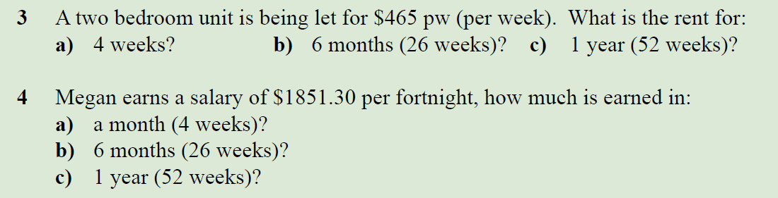
Task

